Slide 1
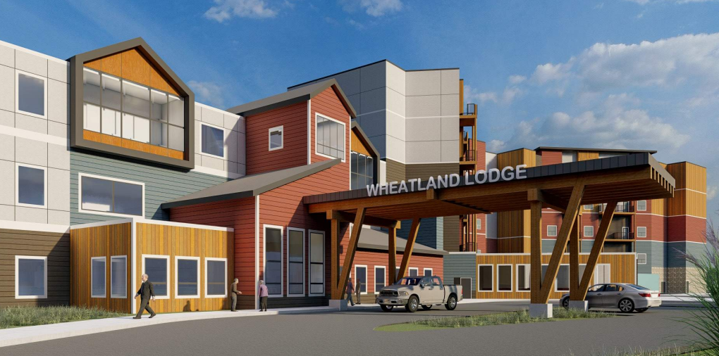

The Lodge Program Alignment
Financial Programs Update
Phased Build Plan and Financial Assessment
Feb16, 2023

Slide 2
Crash Course
Seniors Lodge Program

Slide 3
Crash Course – Seniors Lodges
Governance and operations
The Wheatland Lodge is governed by its Ministerial Order. The responsibility of operations is that of the named Member Municipalities.
Within that order, the Foundation is empowered to requisition funds to off-set annual operating expenditures that exceed that of revenues.
The original intent of the Lodge program is to serve low-income seniors, and with the agreement, Lodge operations are subject to a regulatory environment.

Slide 4
Crash Course – Seniors Lodges
Services and Rates
The Lodge program provides rooms, meals, light housekeeping services and recreational opportunities for seniors who do not require care in a specialized health care facility.
Each local housing provider sets their own lodge rates and these rates vary between regions. Regardless of the monthly lodge rate, each resident must be left with at least $342 in monthly disposable income.

Slide 5
Crash Course – Seniors Lodges
Services and Rates
The Government of Alberta manages the Lodge Assistance Program (LAP). Residents that have an income of less than $30,000 qualify for the program.
Currently the program pays $13.27 per day to offset the impact of discounted services and lodge service costs.
WHMB*:
Rent : $ 1,500
LAP supplements $ 225
Municipal requisition $ 400
Operational break-even: $ 2,225
*Based on current operations - 2022 Budget
65%
occupants
LAP
cutoff
35%
occupants

Slide 6
Community Service Model

Slide 7
Program Alignment
 | Community Service | Community Affordable ‘A’ | Community Affordable ‘B’ | Market
Current Income Mix (Existing Lodge) | < 30K (RGI) | 30K - $40K | 40K - $50K | +50K
 | 57% | 12% | 11% | 15%
 | Private Room | Studio | One BR
Portfolio | 42% | 25% | 28%
Existing Lodge | 89 units
Proposed Lodge |  | 120 Units | 36 units
Portfolio Mix
10% up-shift

Slide 8
Community Affordable Model
Revenue Model and Program Alignment
Alberta Average Rent = $2855
‘Bachelor/Private Room with Meals included’
 | Units | Total Charge
Lodge (existing) | 89 | $ 1800 (avg) | Lodge Assistance Program ($2200- RGI Discount)
Studio Basic | 12 | $ 2200 | AHPP Alignment
Studio /kitchenette | 72 | $ 2600 | AHPP Alignment
One Bedroom | 36 | $ 3100
Community
Service
Community
Affordable
LAP
cutoff

Slide 9
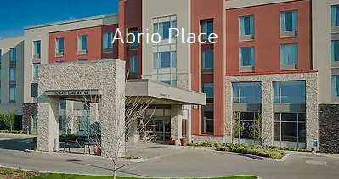
Community Affordable Model
Environmental Scan
Abrio Place
Rockyview Foundation
92 units:
64 subsidized – studio rooms
Rents based on rent-geared to income (> $2000)
28 community affordable* – studios with larger sitting area
*Rents are not set, but indicated at $2700 (conversation only with administrator)
Current waitlist 265
Project to open Aug 2023
Total project budget including renovations not provided.

Slide 10
Community Affordable Model
Discussion
            Historical Role of Lodge
            Lodge Re-positioning, and
            Community affordable model

Slide 11
Demand, Delivery and
Resource Rationalization

Slide 12
Demand Assessment
Population 80+
10% of population served by WHMB
Population 85+
25% of population served by WHMB
Demand assessment to meet current service levels
Demand assessment based on statistics Canada:
Population assessment
Mortality rates
Net migration not included in assessment
Current Lodge 89 rooms
Wait List = 20
(+ growing)

Slide 13
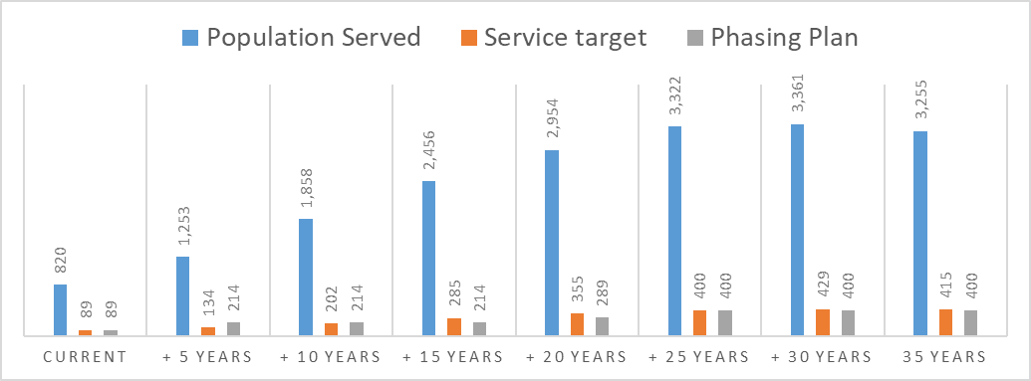
Demand Assessment and Delivery Strategy
2021
New Build A (2 phases) 120 units + 80 units
Current Lodge 89 Units
New Build B - Future 200 units

Slide 14
Environmental Scan
 | # seniors 85 + | Wheatland Lodge and Lakeshore room count combined | % of seniors served | Additional Units to maintain 30% catchment unit count |  | % of seniors served | Total Unit count to maintain supply 85+
2026 | 569 | 169 | 30% |  |  | 30% | 169
2031 | 876 |  | 19% | + 93 units |  |  | 262
2036 | 1277 |  | 13% | +214 units |  |  | 383
2041 | 1636 |  | 10% | +490 units |  |  | 659
Lakeshore Manor = 80 Units
Wheatland Lodge = 89 Units
169 Units
Lakeshore Manor = 80 Units
Wheatland Lodge = 89 Units
Proposed Project = 120 Units
289 Units
Inclusion of Long-term Care (Sagewood) is not included.
LTC facilities are managed by AHS and utilize placement by availability, and not restricted to the local catchment.
Future LTC requirements are managed by AHS.

Slide 15
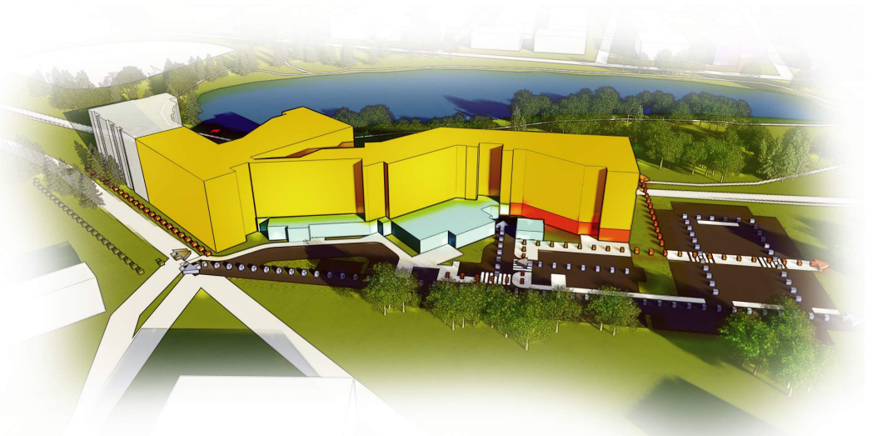
Project Rationalization
Original Concept – Barry Architecture

Slide 16
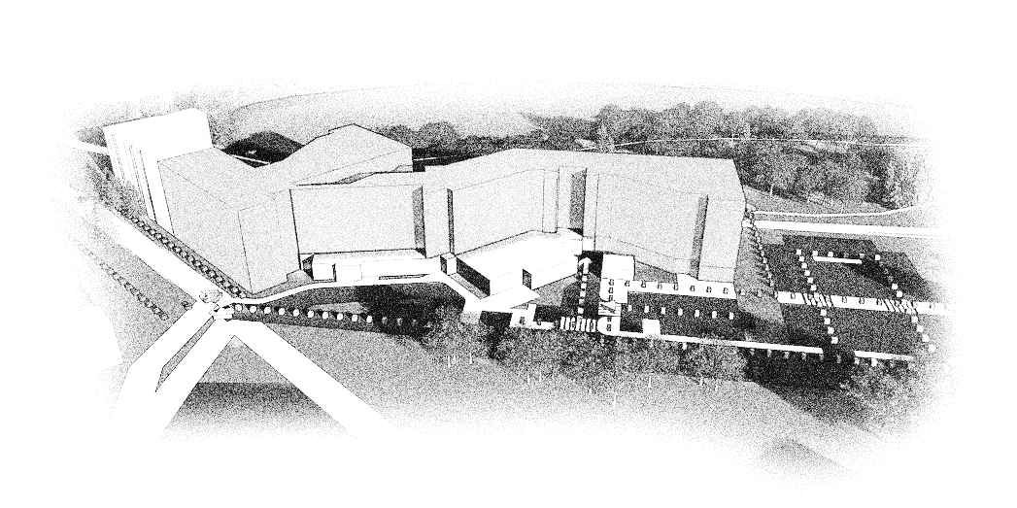
Project Rationalization
Reduced Scope

Slide 17


Project Rationalization
Phased Development and Demand Alignment
Future - ‘Phased development Planning’
May be by WHMB, for future community affordable or possible attraction for market level development

Slide 18
Resource Rationalization
Planning and Demand
Project scale modified 120 units from original 170 units proposed to reduce costs
Retention of the existing lodge to support projected demand
Methodology
Introduce new lodge housing streams to strengthen ongoing revenues
- Community Service (existing lodge)
- Community Affordable (proposed project rent model)
Capital Requirements
Order of Magnitude budget re-assessed.
- Updated cost estimate is > $290,000 per door for units plus
$160,000 per door for supportive living gross up requirements.
Funding Programs
Leverage Affordable Housing Partnership Program (Province) for capital contribution.
Leverage CMHC National Housing Co-Investment Program for loan and capital contribution.

Slide 19
Resource Rationalization
Existing Lodge
What is the value of the existing lodge - $ 10 M (2022 valuation – Altus Group)
Should the existing lodge be retired?
Constructed in the 1960’s the existing Lodge does not meet current standards
Potential residents have a difficult time accepting the facility due the environment, particularity the individual rooms.
Can the existing lodge be retired?
With the advent of Lakeshore, additional capacity of 50 units above current community is projected, this capacity will quickly dwindle.
If expanding demand does not materialize, WHMB has at its option to close the existing lodge.
  Assuming that action is taken, current requisitions supporting the lodge would transfer to the new lodge.
  Impact to meet low income rent thresholds would need to be taken into account.
  Application of existing lodge value to the project would need to be taken into account.

Slide 20
Demand, Delivery and Resource Rationalization
Discussion
            Demand projections
            Use of existing lodge and phased development planning
            Role of the lodge / resource strategy

Slide 21
Financial Programs

Slide 22
Government of Alberta
Future of Lodges
The province has embarked on a 10-year program to revise how affordable housing is managed, including the Lodge program.
The objective of the province is to shift away from direct ownership and update the approach to regulations and support.
This fundamental shift allows the Lodges to re-focus on needs of the community, not just low income.
The Affordable Housing Partnership Framework program was announced Dec 7, 2022 - $55M cost sharing program.

Slide 23


Government of Alberta
Affordable Housing Partnership Program
What does it require?
70% of units meet affordability definition
What’s the benefit?
Up to 1/3 Contribution
Maximum contribution defined as $85K per qualifying unit
What does it promote?
Mixed below market affordable rental/service bands
Fund Stacking
Program Intake
April – June 2023

Slide 24
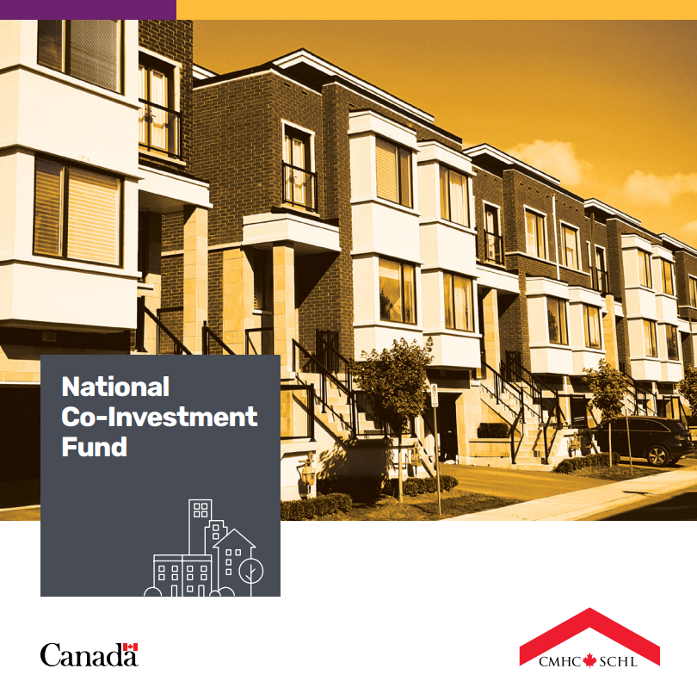
Government of Canada
CMHC - National Co-Investment Funding
What does it require?
Energy Efficient
Accessible
Affordable
Higher level of oversight
What’s the benefit?
Low Interest Rates (current indicative rate 2.85%)
Forgivable loan portion
Up to 50-year Amortization
Low Debt Coverage Ratio Accepted
What’s the requirement?
Minimum 30% of units 20% below market
Minimum 25% equity contribution
from partner(s)
10 yr Program Scheduled to complete 2026

Slide 25
Financial Programs
Discussion
            Federal and Provincial programs
            Provincial strategy, and
            Municipal responsibility for capital

Slide 26
Financial Assessment

Slide 27
KEY ASSUMPTIONS
CAPITAL PERFORMANCE
Minimum Debt Contribution Ratio of 1.1
Loan interest rate 3.85%
(current indicative rate 2.85%)
REVENUES
Two Person Occupancy
50% service charge for second occupant
6% of units double occupied
Misc. Revenues
Alignment with existing Lodge on per unit basis
$40 per unit per month parking – 30% of units
Requisitions
$500K assumed for new building (debt repayment)
Requisitions for existing lodge building to continue
CAPITAL BUILD
Wood Construction / Concrete Podium
Surface Parking
Designate common areas follow provincial guidelines
Additional capital costs for Hospice 100% funded (assessment for lodge only – not included)
OPERATING
Based on Current Lodge
No Municipal Taxes
5% Efficiency adjustment
5% Energy consumption adjustment
Hospice
Annual operating budget is funded
(assessment for lodge only – not included)

Slide 28
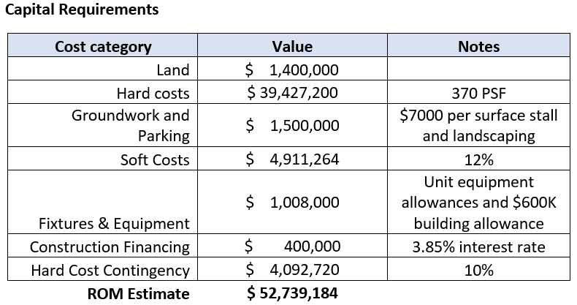
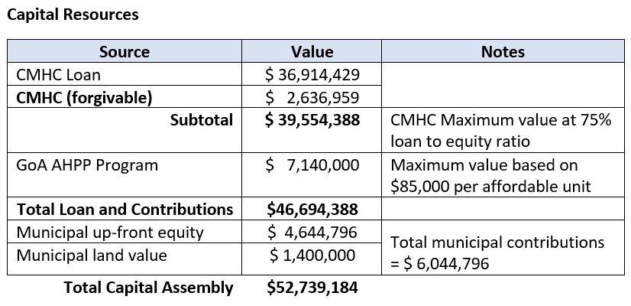
Capital Requirements and Resources

Slide 29
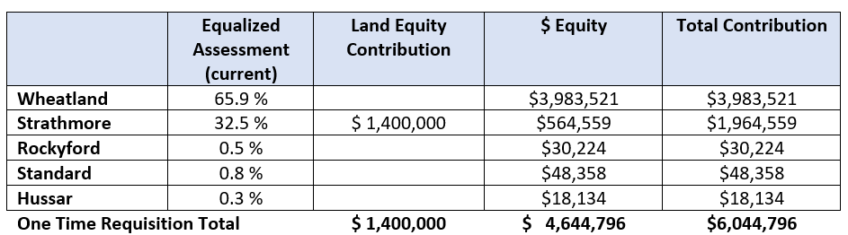
Equalized Assessment – One Time
‘2024’ - Timing of capital to be based on project cashflow schedule and on timing of AHPP contribution

Slide 30
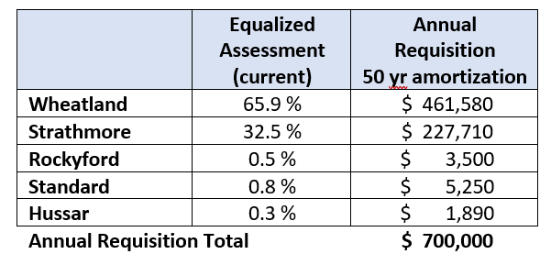
Equalized Assessment – Ongoing / Loan Repayment
Requisitions start at YR 1 operations
Values do not account for impact of CMHC loan forgiveness (years 1 – 10)

Slide 31
GoA and CMHC values
GoA Contribution
Based on current AHPP program definitions
AHPP definitions are based on Lodge, a higher cost base form of housing
WHMB has at its option to ask for funding greater than the current program definition
If contributions greater than what is outlined are requested, the project team is to justify such request.
CMHC Loan and Contribution
Calculations are based to maximize the possible loan value with CMHC due to interest rates provided are currently lower than municipal borrowing rates.
Municipal Requestions are to support debt repayment only, the strengthened revenue stream model removes operational requisitions for the new lodge.
CMHC ‘forgivable’ loan portion is provided over the first 10 years. Assuming no changes to the initial order of magnitude assessment, municipal requisitions may reduce or be used accelerate payment of the loan.

Slide 32
Financial Assessment
Discussion
            Provincial cost sharing
            Debt Financing
            Equalized Assessment

Slide 33
Project Advancement and off-ramps

Slide 34
Development Milestones
PHASE 1
PHASE 2
PHASE 3
PHASE 4
Conditional
Municipal
Commitment
Municipal
reporting &
commitment
confirmation
Municipal
reporting &
commitment
confirmation
Municipal
reporting &
commitment
confirmation
Current
Municipal
Understanding
Municipal
Support
AHPP Submission
CMHC Submission
CMHC Term Sheet
AHPP Approval
CMHC Approval
Q1
Q2
Q3
Q4
Q1
Construction
PM
Service Acquisition
Primary Assessment
Class C Budget
Class B Budget
Tender Ready
Construction Contract
Prime Consultant Team
Off-ramp
Off-ramp
Off-ramp

